Slide 1
Living in the 21st Century
Global inflation and the rising costs of living

Slide 2
PROJECT PREWORK - ETL
Extracted relevant datasets from websites.
Imported the files into jupyter notebook to create dataframes to clean for duplicates, nulls and renamed headers for readability.
Appended files with another database to include global coordinates and multi-polygon coordinates for mapping.
Created Geojson and Json files to load the data into map, table or chart formats.

Slide 3
PROJECT VISUALIZATION TOOLS
Created a dashboard with interactive chart, table and choropleth map.
Used JS, HTML/CSS and plotly to create an interactive bar graph of inflation rates per country.
Used JS, HTML/CSS and leaflet to create an interactive choropleth map of inflation rates per country.
Used JS and HTML/CSS to create a scrollable table showing average costs per city across the globe.

Slide 4
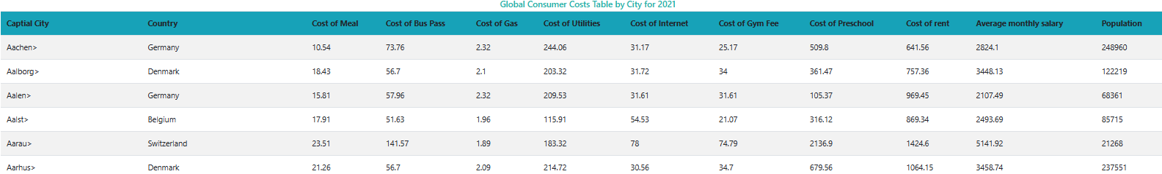
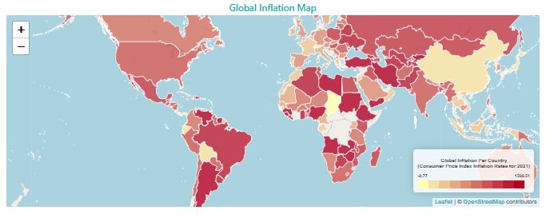
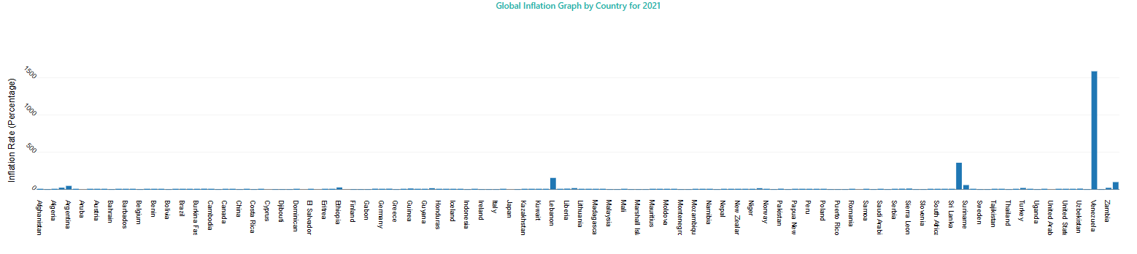
PROJECT VISUALIZATIONS

Slide 5
Blank slide
PROJECT
WRAP UP
The living in the 21st Century project analyzed the rising costs of living expenses across the globe. We examined inflation rates per country and the average price people pay for goods and services such as gas, housing and utilities.
The two datasets selected for the analysis were “Global Cost of Living” from Kaggle which provided the average consumer expense cost per city and “Global Database of Inflation” from the World Bank which contained inflation rates per year, per country.
These datasets were extracted, cleaned and loaded into PGAdmin SQL server. Geojson and json files were then created to use as files in visual projections of the data in an HTML format.

Slide 6
Datasets used for project
Global cost of living v2 - https://www.kaggle.com/datasets/mvieira101/global-cost-of-living
Global database of inflation - https://www.worldbank.org/en/research/brief/inflation-database
World Cities Database - http://simplemaps.com
Countries Database - https://gist.githubusercontent.com/erdem/8c7d26765831d0f9a8c62f02782ae00d/raw/248037cd701af0a4957cce340dabb0fd04e38f4c/countries.json

